Slide 1


Slide 2

INDIAN CENSUS DATA 2011
Presented By : Himanshi Kumari
Enrollment No:EBEON0322582949

Slide 3



Technology used :
PYTHON
MYSQL
MS EXCEL

Slide 4

What is census?
“Population” census is the total process of collecting ,compiling , analyzing or otherwise disseminating demographic economic and social data pertaining at a specific time of all person in a country.
IMPORTANCE OF CENSUS:
The census provides information on size distribution and socio-economic , Demographic and other characteristics of country population.

Slide 5
ABSTRACT:
The paper presents a method of projecting census data of a nation as Big Data for Analytics purpose. Census Data provides the demographics and details of the geographical, social and economic status of a country. This data are recorded once in a decade and is maintained by government. In India also we have a census data recording since 1872. We can imagine if we combine these data we will get a treasure of information which will be beneficial for the government, policy maker, planning commission to mend and implement beneficial policies and laws for citizens of the country. The paper explores the opportunities that will be created if we digitalized this historical data and use it for analytic purpose. It also discovers some suitable technologies that can be suited to develop such tool.

Slide 6
Indian Data census Analysis using MySQL

Slide 7
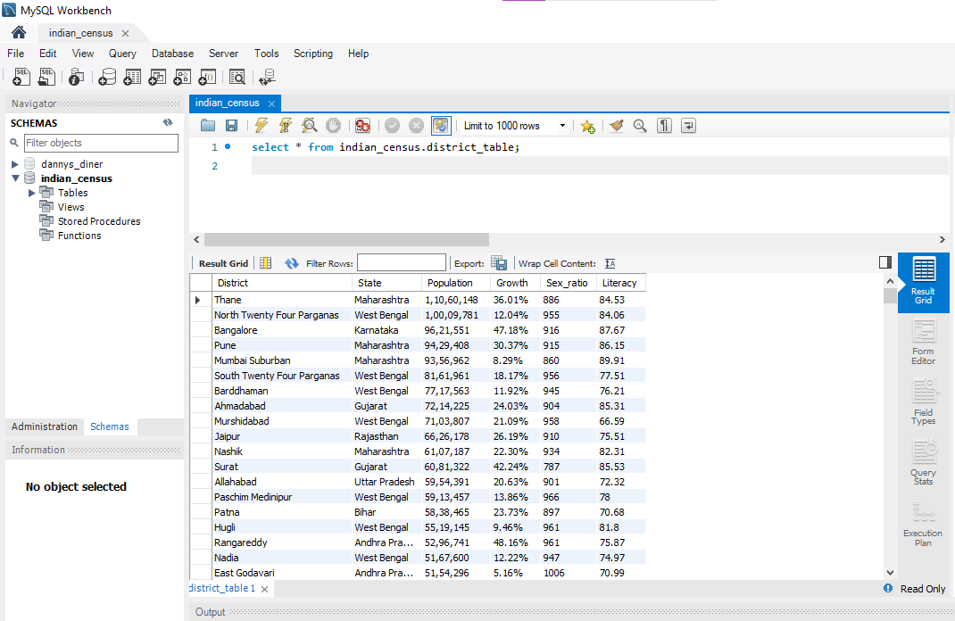
Data Table

Slide 8
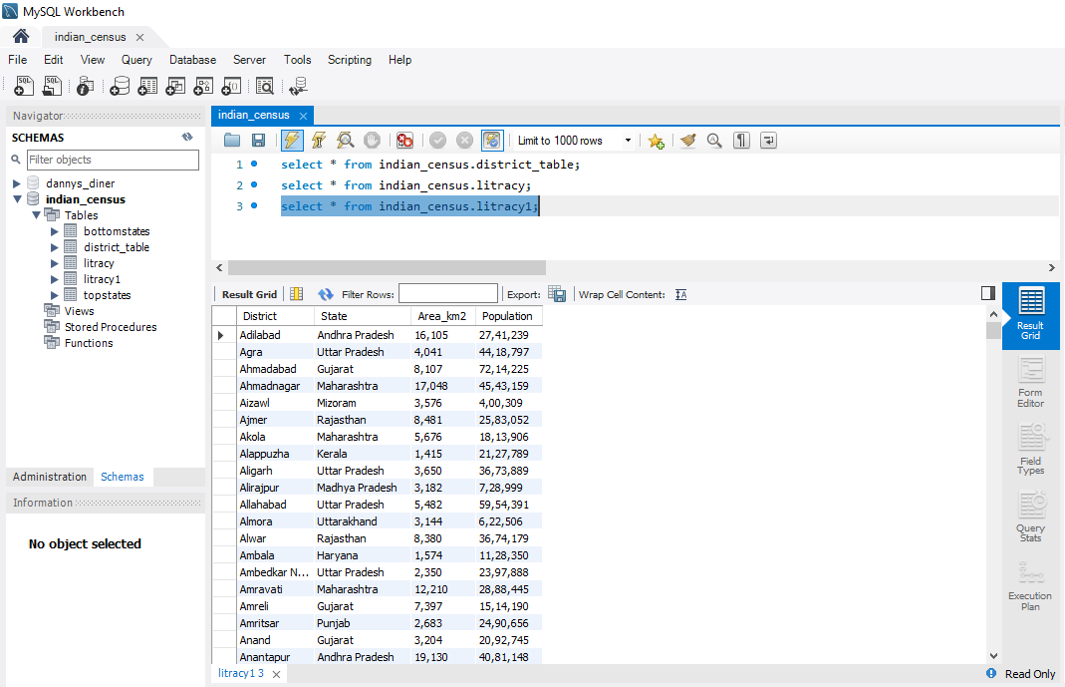

Slide 9
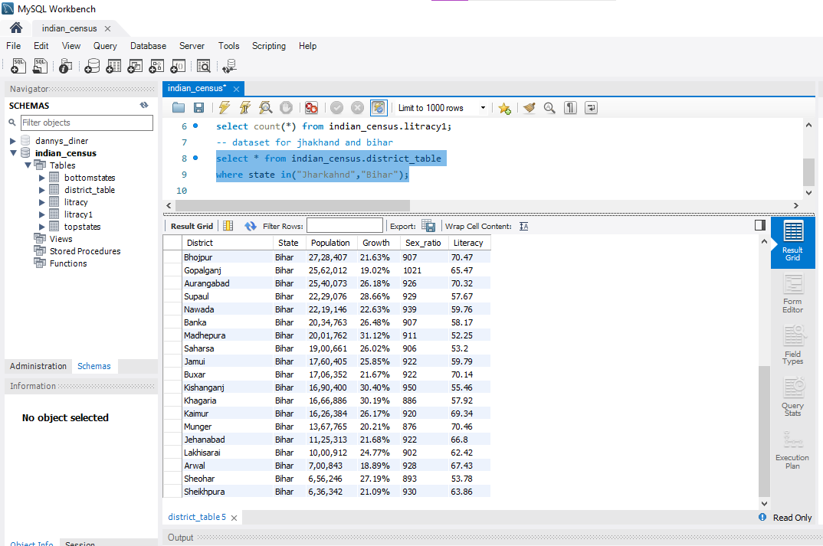

Slide 10
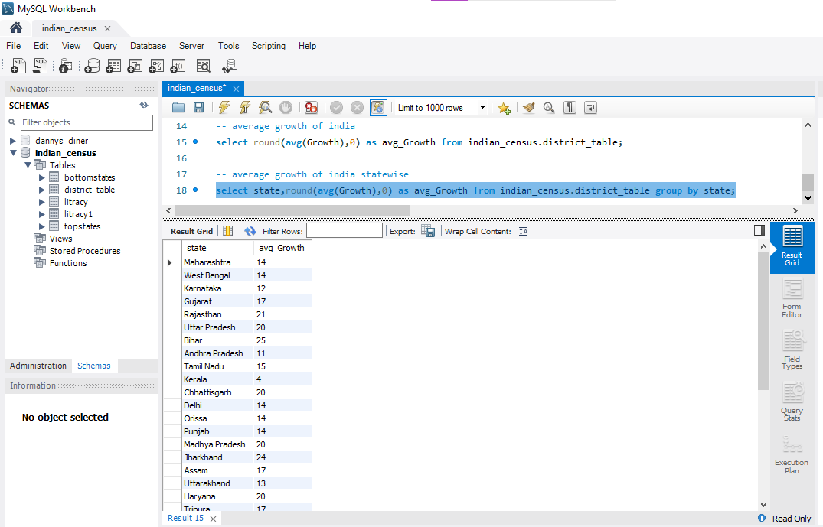

Slide 11
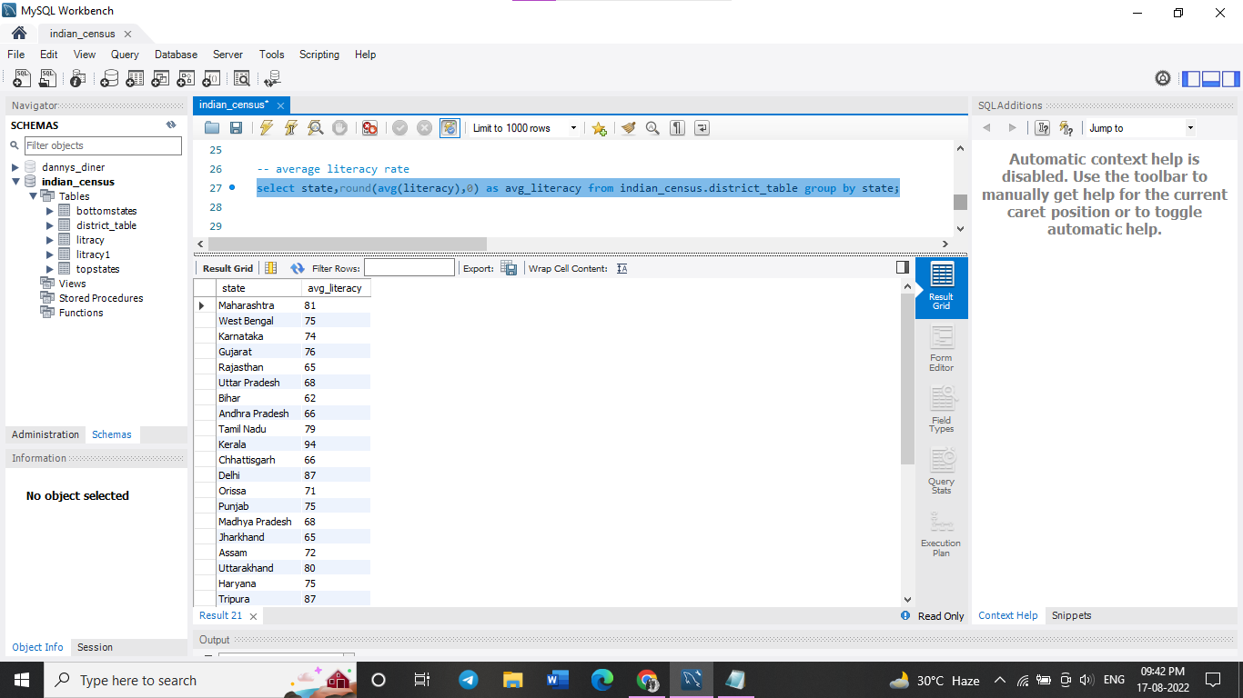

Slide 12
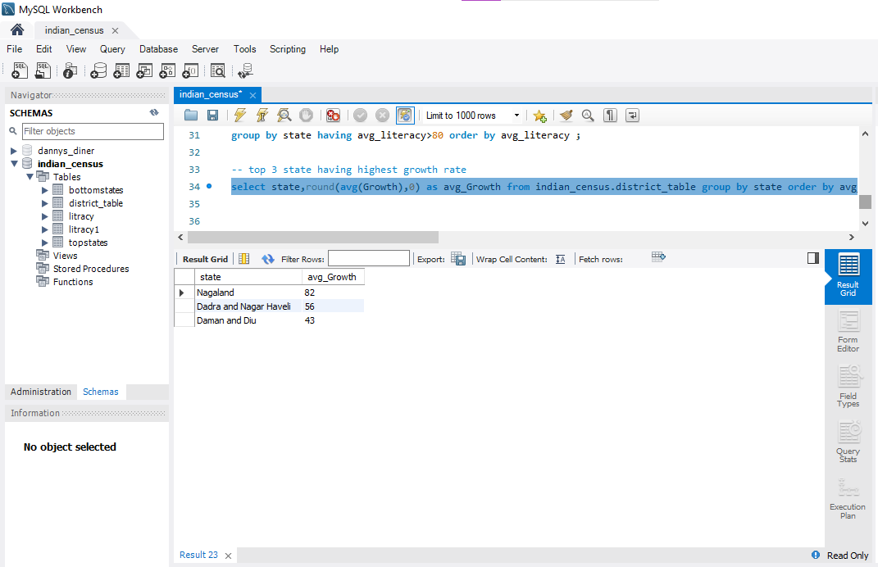

Slide 13
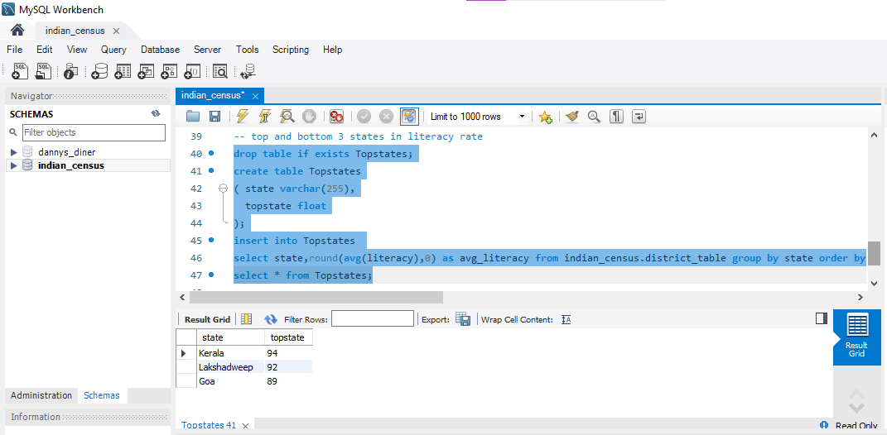

Slide 14
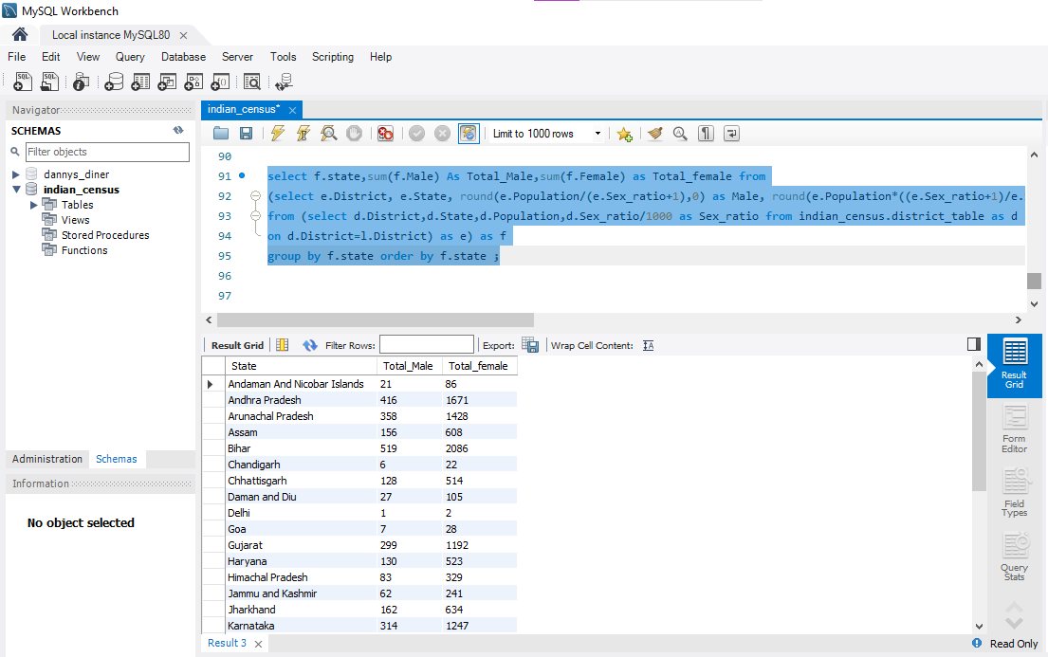

Slide 15
Indian data census data analysis using python

Slide 16
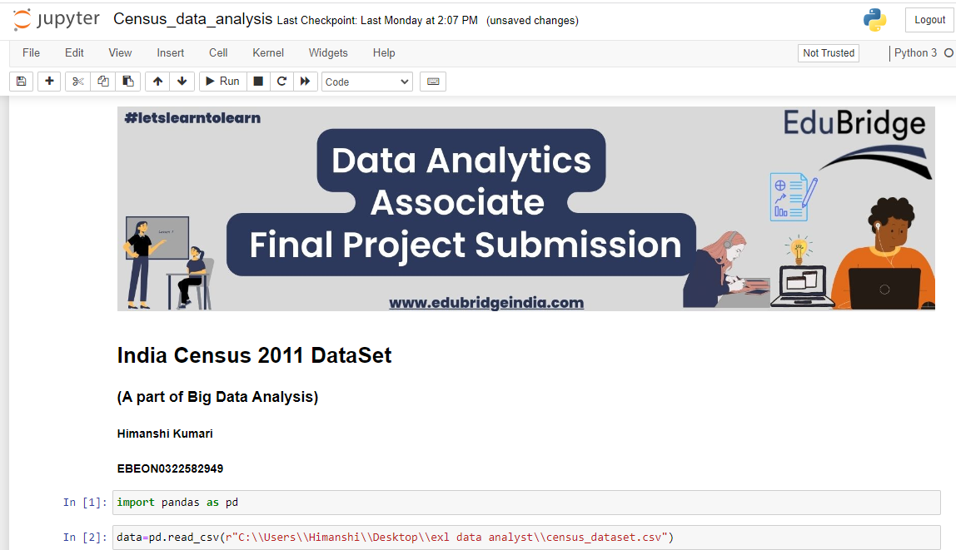

Slide 17
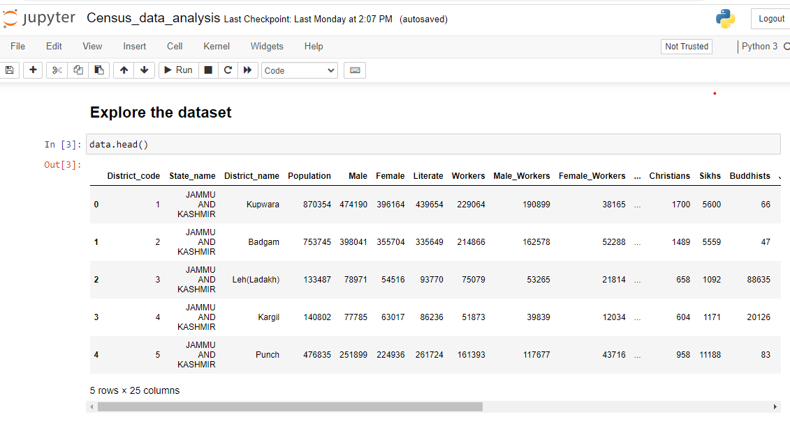

Slide 18
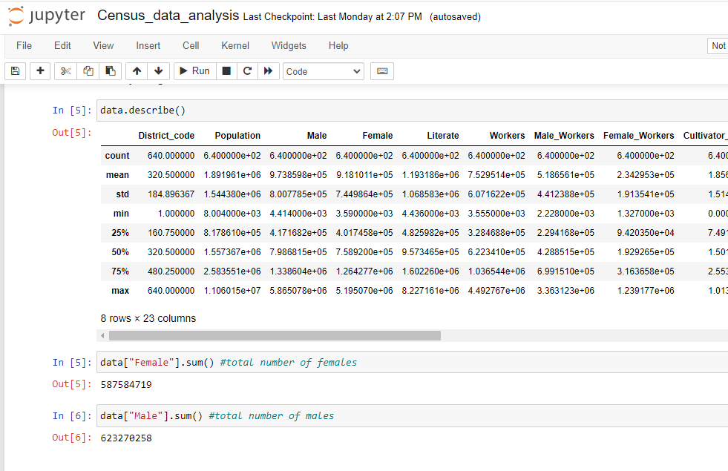

Slide 19
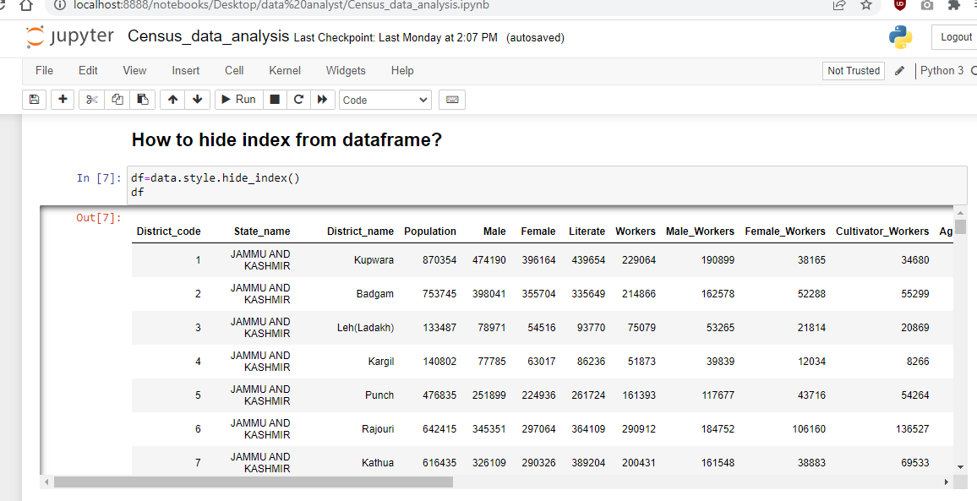

Slide 20
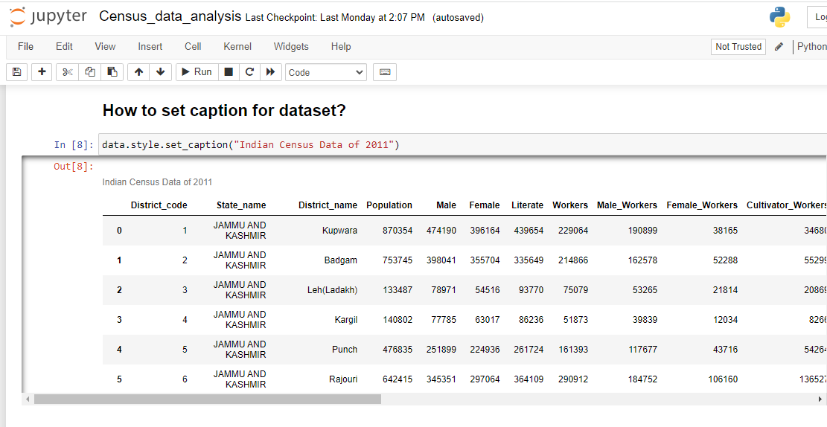

Slide 21
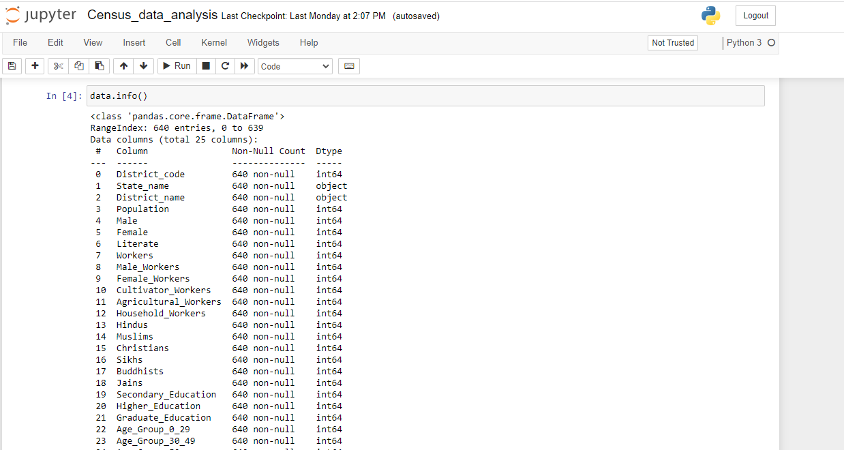
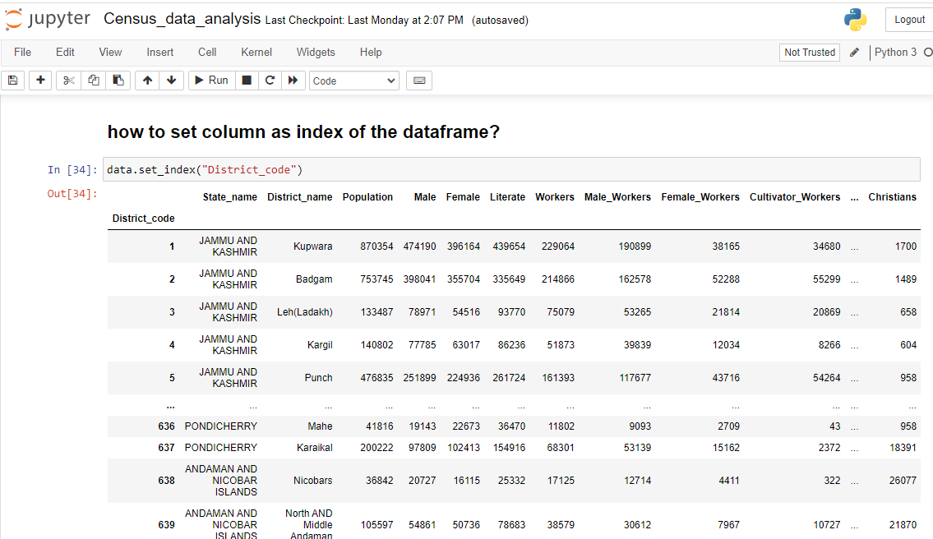

Slide 22
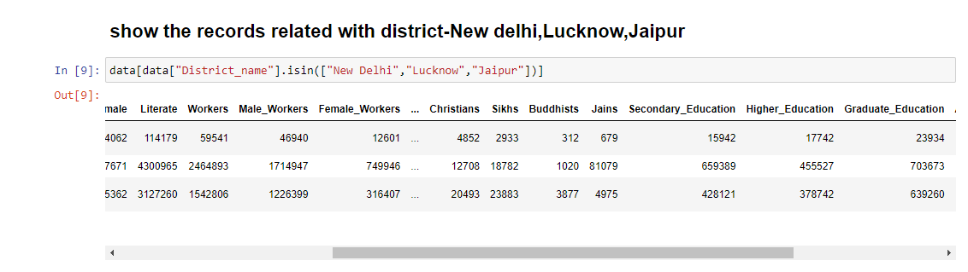

Slide 23
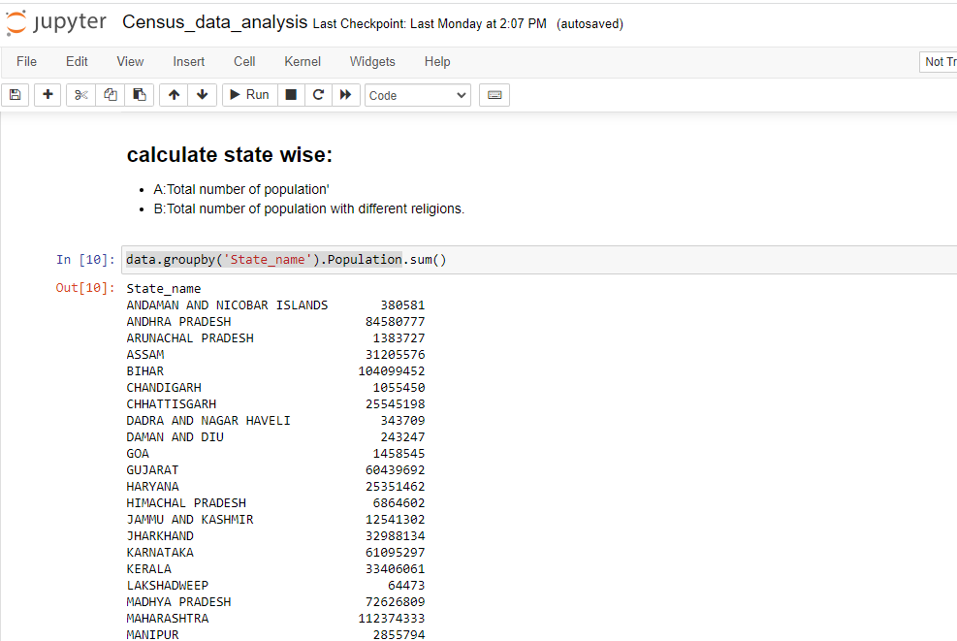

Slide 24
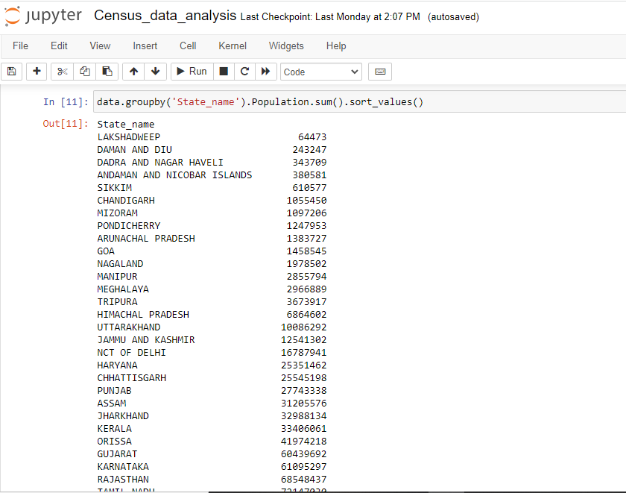

Slide 25
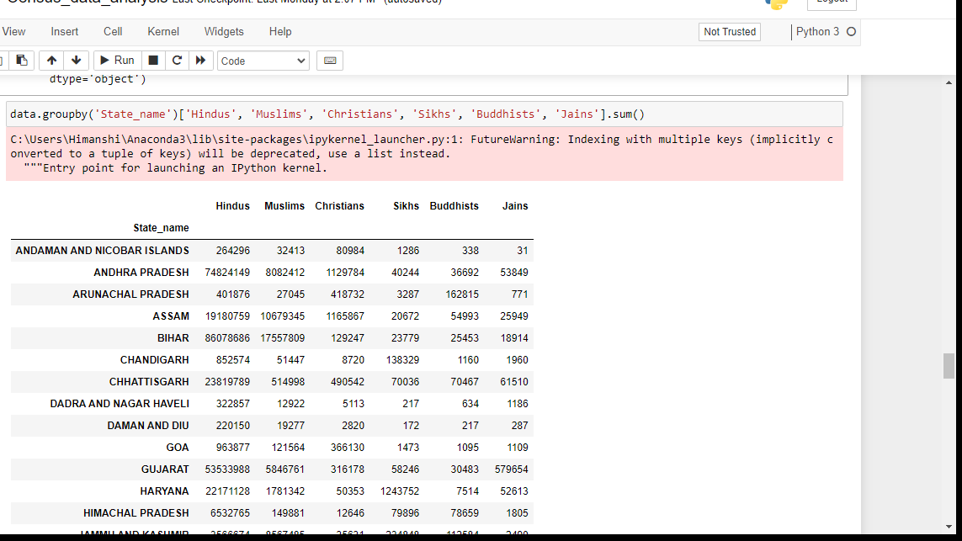

Slide 26
Thank You

